Slide 1

NYPD Arrests Dataset
By: Ankit, Kristin, Sai, Surakshya, Tenzin

Slide 2
Contents
INTRODUCTION
CLEANING AND FEATURE REDUCTION
VISUALIZATION
INTERPRETATION OF THE DATASET: A word of caution
MODELS
CLUSTERING (K-Modes and Hierarchical)
Supervised Classification
CONCLUSION

Slide 3
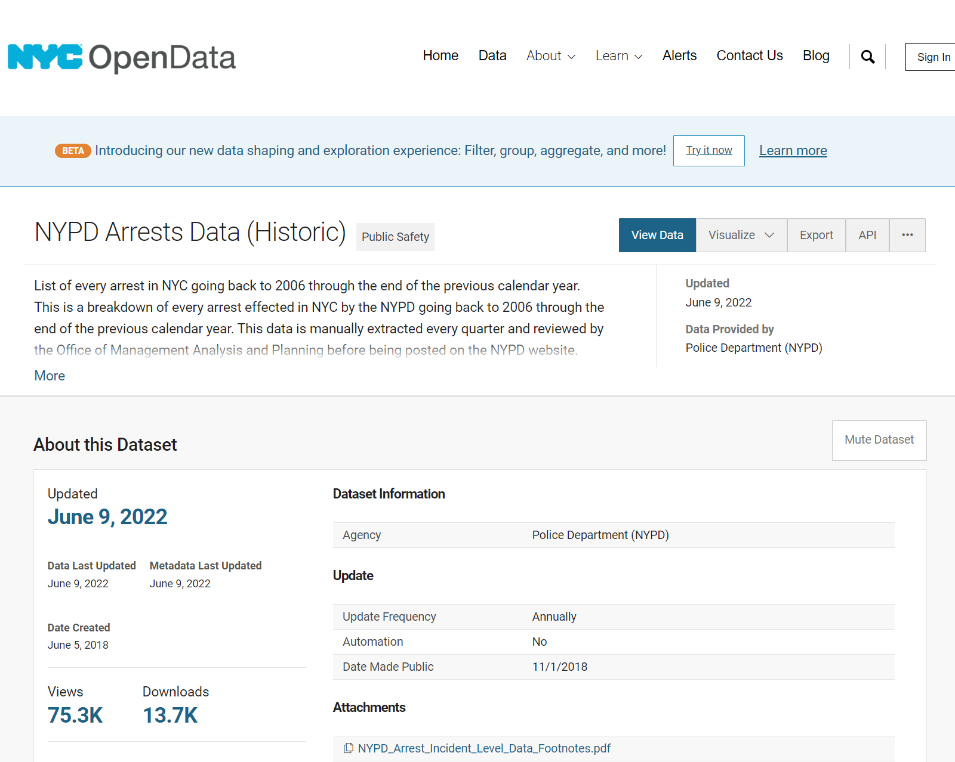
INTRODUCTION
Data Source
NYC Open Data website
Posted on the NYPD website after review by the Office of Management Analysis and Planning
https://data.cityofnewyork.us/Public-Safety/NYPD-Arrests-Data-Historic-/8h9b-rp9u
Notes:
surakshya

Slide 4
Introduction
Data recorded for arrests in NYC by the NYPD from 2006 through 2021.
5.31M observations and 19 columns
We used the data from 2019 through 2021 by filtering with ARREST_DATE.
509,989 observations and 19 columns
Features in the dataset : ARREST_KEY, ARREST_DATE, PD_CD, PD_DESC, KY_CD, OFNS_DESC, LAW_CODE, LAW_CAT_CD, ARREST_BORO, ARREST_PRECINCT, JURISDICTION_CODE, AGE_GROUP, PERP_SEX, PERP_RACE, X_COORD_CD, Y_COORD_CD, Latitude, Longitude, LonLat
Notes:
Introduce features
Surakshya

Slide 5
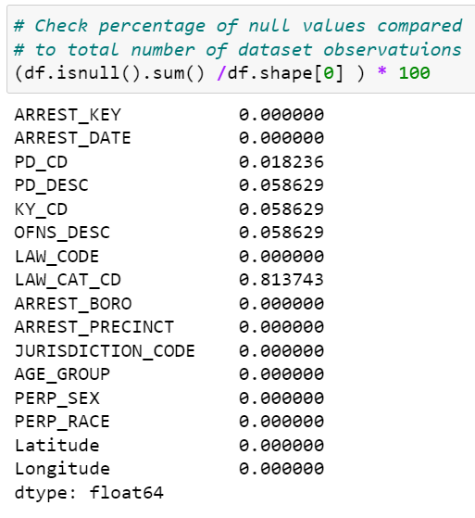
Data Preprocessing
No duplicate rows
Dropped 'X_COORD_CD', 'Y_COORD_CD', 'Lon_Lat'
Columns with null values were likely to be redundant features
Less that 1% null values present for columns with missing values
Remove NaN rows
Notes:
Surakshya

Slide 6
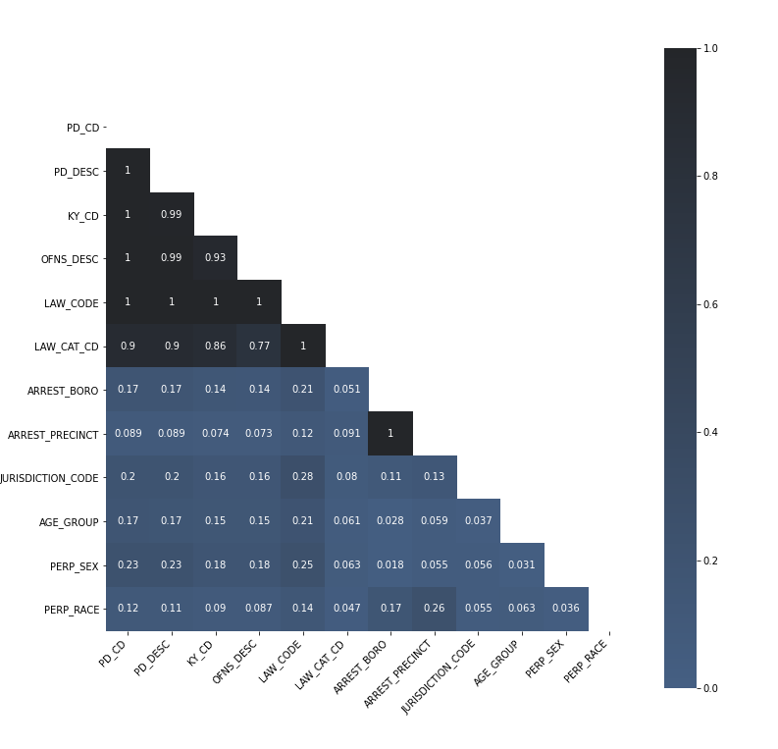
Feature Reduction
Used CramersV from association_metrics to find associations (how related variables are)
Based on Pearson’s Chi-squared test (range from 0 to 1)
PD_CD, PD_DESC, KY_CD, OFNS_DESC, LAW_CODE and LAW_CAT_CD : Classification codes for the type of crime, different level of granularity
ARREST_PRECINCT and ARREST_BORO
Notes:
Used CramersV from association_metrics to find associations between categorical variables (how related variables are)
CramersV is based on Pearson’s Chi-squared test to measure association between two categorical variables (range from 0 to 1)
Expected for PD_CD, PD_DESC, KY_CD, OFNS_DESC, LAW_CODE and LAW_CAT_CD to be associated since all these variables are classification codes for the type of crime with the only difference being the level of granularity
ARREST_PRECINCT and ARREST_BORO
CramerV function is symmetrical
The purpose of this test is to determine if a difference between observed data and expected data is due to chance, or if it is due to a relationship between the variables you are studying.
Best for nominal variables
Use this when building models, keeping only the variables of interest without having other variables associated with it

Slide 7
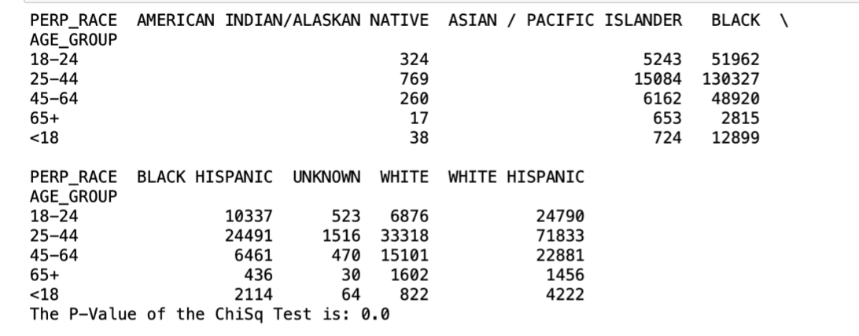
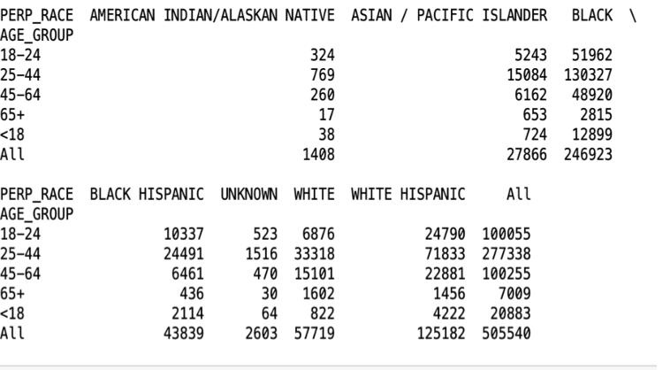
Used Chi-squared test to measure association between two categorical variables Age_group and perp_race.
As you can see in figure 1 and 2 we used The Pandas crosstab function to customize data.
For Figure 1 we used chi2_contingency to figure out the p-value of the ChiSq which in this case is 0.0.
It is possible but not likely for the p-value to be 0.0. This brings me to What is a Null Hypothesis?
As you can see from figure 2, 0.0000000000016569891904275434 is the p-value, 54.25 is the statistical value, and 2 is the degree of freedom. We used chi2_contingency to find this. As the p-value is less than than 0.05, we reject the null hypothesis that there's no difference between the means and conclude that a significant difference does exist
Fig. 1
Fig. 2

Slide 8
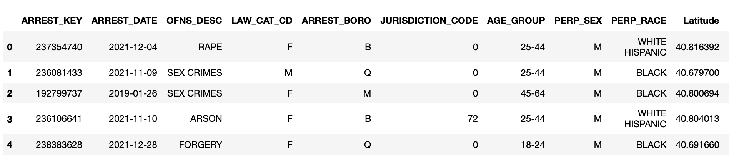
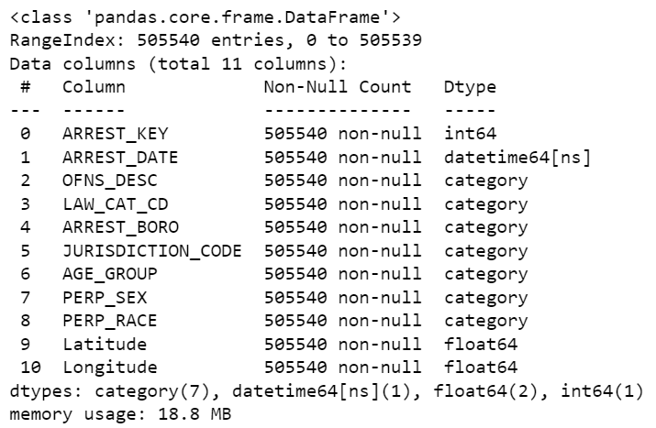

Slide 9
Visualization
Notes:
tenzin

Slide 10
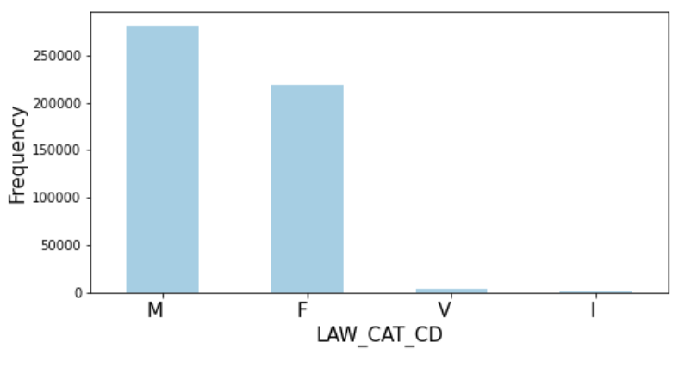
Variables of Interest
M= Misdemeanor
F=Felony
V=Violation
I=Traffic
Categorical variables in our dataset
Imbalanced dataset
Took this into account when performing our machine learning models
Notes:
A misdemeanor, simply put, is a minor crime, while a felony is a serious crime that can land you in jail or prison for many years or even the rest of your life.
violations include offenses such as Disorderly Conduct, Harassment in the Second Degree, and Unlawful Possession of Marihuana. Typically, violations are punishable by a fine, mandatory state surcharge, community service, issuance of an order or protection, or up to 15 days in jail.
This is one of the variables we hoped to use for predicting classification on the type of crime

Slide 11
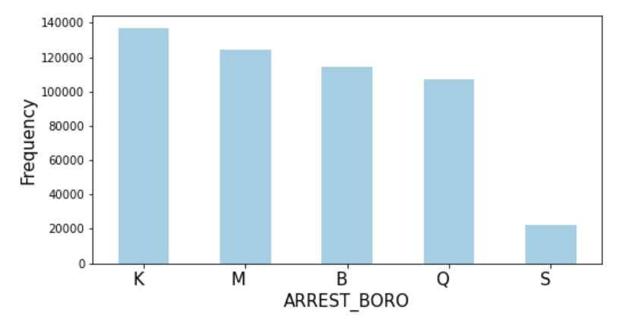
Variables of Interest
K= Brooklyn
M=Manhattan
B=Bronx
Q=Queens
S=Staten Island
Notes:
Brooklyn has the higher number of arrests followed by manhattan, bronx, queens and Staten Island
Staten island has significantly lower arrests which may due to the smaller geographic area but regardless shows that this variable is imbalanced

Slide 12
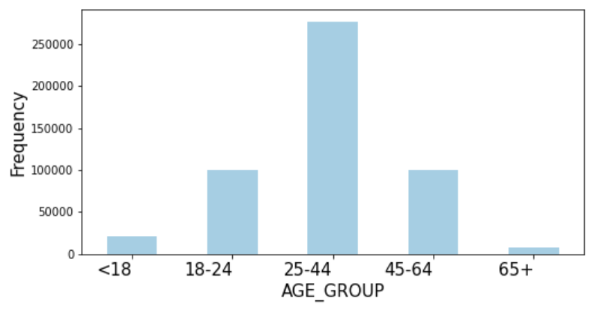
Variables of Interest

Slide 13
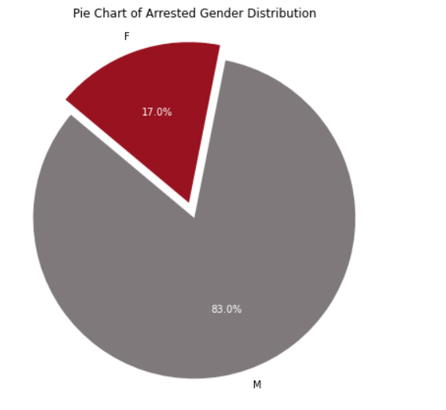
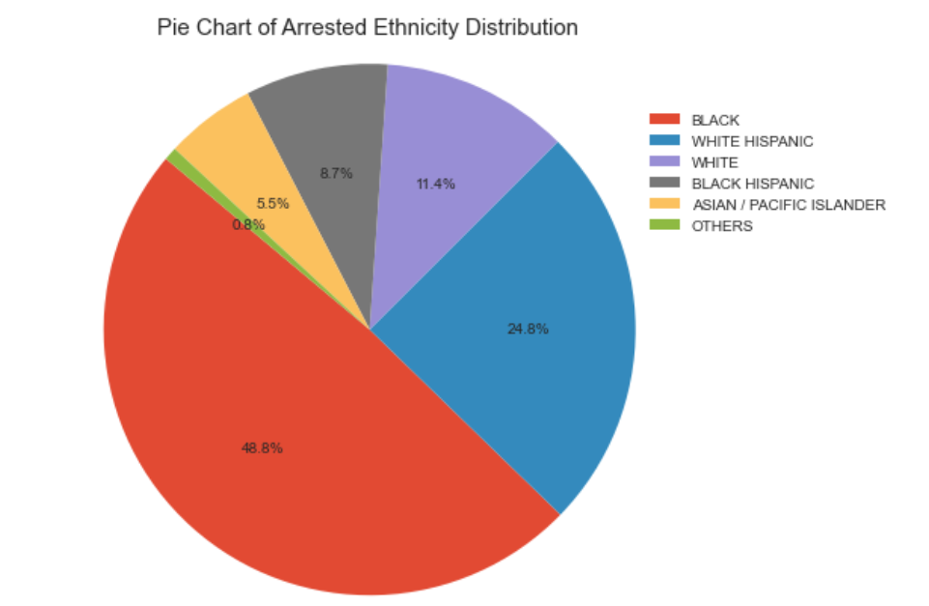
Demographics
Notes:
Tenzin
For example, it should not be formulated that Men and Black population are more likely to commit crime

Slide 14
Caution with Interpretations
It must be noted that the dataset is an arrests dataset and doesn’t contain information about judicial rulings after arrest, etc.
So one should not formulate that certain race or gender are more likely to commit crimes
It could well be that these populations are disproportionately arrested due to underlying discriminatory practices

Slide 15
CLUSTERING
- Unsupervised classification
Notes:
Research Question: Can arrests be classified under groups? Are some demographic traits more dominant here in certain groups?
We will use clustering methods like K-modes and Hierarchical Clustering to see which model works better and gives us clear sight of the groups and subgroups of the data.

Slide 16
Hierarchical Clustering
We were interested in performing this model because it groups data into clusters(Dendrogram)
Two types: Divisive and Agglomerative
We used Agglomerative clustering
Bottom-up approach

Slide 17
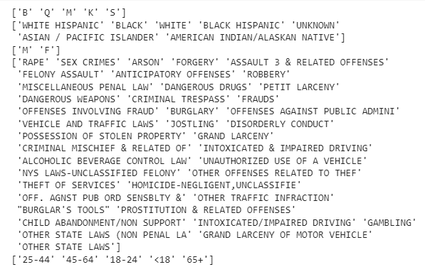
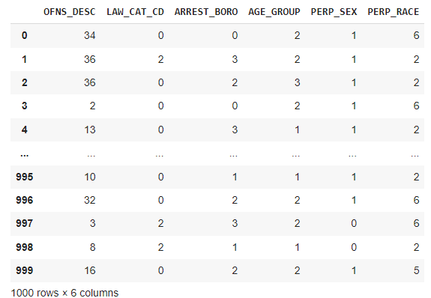
Can arrests be classified into groups?
We used columns OFNS_DESC, LAW_CAT_CD, ARREST_BORO, AGE_GROUP, PERP_SEX, PERP_RACE
The datatype of all the columns are “object”
We used label encoding to change categorical values to numerical values for all columns except the AGE_GROUP
We used ordinal encoding for the age group.

Slide 18
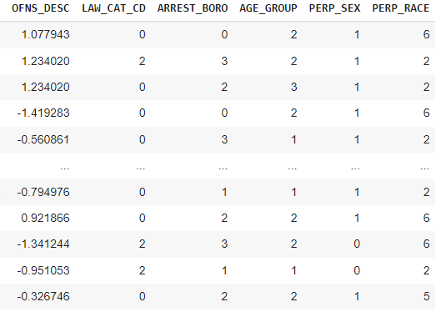
Standardized Offense Description
We standardized OFNS_DESC because the other columns had values in the single digits after encoding. But OFNS_DESC had values that went up to 50. We didn’t want to make the model unbalanced.

Slide 19
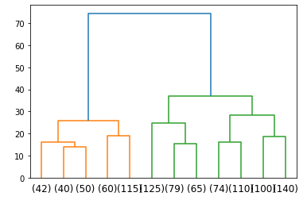
Dendrogram
Similar predictors are clustered together.
Truncated the last 12 clusters of the dendrogram
This makes it more easy to read.
Single linkage clustering: measures the minimal distance between clusters.

Slide 20
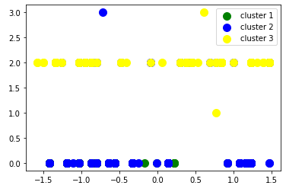
Agglomerative Clustering
Made a scatterplot of the clustering.
This is another way to visualize the clustering using hierarchical clustering technique.
This also shows the clusters between the predictors.
Notes:
Swarmplot

Slide 21
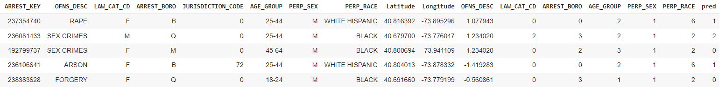
Combined both initial and standardized dataset which shows complete data including predicted cluster grouping.

Slide 22
Findings
We performed Hierarchical clustering in hopes of achieving a visualization that is easy to interpret and understand
From the dendrogram, we can see that arrests can be classified into groups. The predicted value shows us which cluster each arrest falls into.
Since our data was large and categorical, we were only able to cluster the first 1000 observations.
Hierarchical clustering is a good method but it takes too much processing capacity and time.

Slide 23
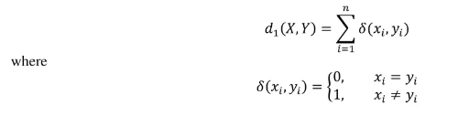

K-Modes
k-Modes clustering was created by Huang in 1998
Derived from the k-Means method
Was created to specifically handle categorical data
Notes:
K-Means clustering is a common unsupervised clustering technique used for large sets of data, but it only works for numerical data. Our data set contained mostly categorical data types, and therefore K-Modes was performed instead because this type of clustering algorithm is able to handle categorical data type. It is very similar to K- means with the exception that instead of the means you are using the frequency to find the modes. The elbow method is used to determine the optimal number of clusters.
Python has a module for kmodes which was heavily used to perform the data processing because it has the kmode algorithm.
Talk about the formula:
D (the distance between two data points X and Y) is calculated by the number of observations in X and Y where dissimilarity between the points are measured. Xi is the values of the ith observation of the X data and yi is the value of the ith observation of the Y data. N is the number of observations. The centroid points are computer from the mode of each column in the dataset. The mode is the data value that occurs most. The formation of the centroid is essentially finding the mode for each column.
Steps:
Select the k using elbow method
Move the observation to the closest cluster based on dissimilarity measure
Check dissimilarity value of each observation against the mode. If an observation turns out that the closest mode is in another cluster, move the observation to the relevant cluster and update the modes
Repeat the step 3 until none of the observation change to another clusters

Slide 24
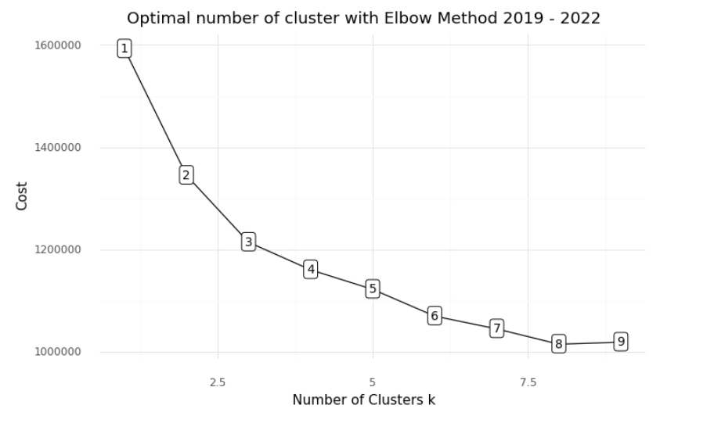
Notes:
A new dataframe was created with only the categorical data. The data frame was then converted into a matrix because kmodes takes in and processes matrices for calculations. The Elbow method is used to determine the optimal number of clusters. The Elbow method takes the value of k at the point when the value does not decrease significantly with the addition of the value k or where you observe an elbow like bend. From the plot the optimal number of cluster is k = 3.

Slide 25

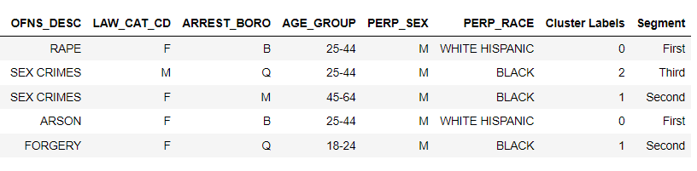
Notes:
Because k = 3, there will be 3 groups or clusters based on the characteristics of the perpetrator and level of offense at the time. Cost is the sum distances of all points to their respective cluster centroids or the dissimilarities between the clusters and in this case the cost is 121,4011.With k = 3 it needs 3 iterations to converge the cost (121,4011). Kmodes.cluster_centroids was used to calculate the centroids. A new dataframe of the aggregate data was created and below is the head of it. This was used to just show which cluster each point fell into.

Slide 26
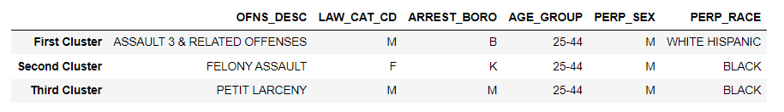
Notes:
These are the three centroids of the three clusters. They were calculated using the built in algorithm in the kmodes python module. (the algorithm is explained more in detail in the first k modes slide). Referring back to the data visualization, you can see that these traits correspond to the traits that occur the most from the data in our dataframe. (assuming the data visualization will show the percentages of each/most categories)

Slide 27
Supervised Classification
Notes:
tenzin

Slide 28
Supervised Machine Learning
No numerical data = no standardization
Categorical variable encoded into numbers
Data split into train and test set (80:20)
Train Data: 404,432 rows
Test Data: 101,108 rows

Slide 29
Supervised Classification
Machine learning Algorithms used:
Logistic Regression
Random Forest
Stochastic Gradient Descent
K Nearest Neighbors
Voting Classifiers:
Hard Voting
Soft Voting
Notes:
1st option: We don’t want Innocent people (or a certain demographic gorp) to be predicted as likely to be arrested. Need less false positives meaning high precision
2nd option: If we don’t want let any to be predicted as likely to be arrested. Need less false positives meaning high precision
Precision: Appropriate when minimizing false positives is the focus.
Recall: Appropriate when minimizing false negatives is the focus

Slide 30
Model Performance
Model | Accuracy | Precision | Recall | F1 Score
Logistic Regression | 0.27 | 0.57 | 0.27 | 0.36
Stochastic Gradient Descent (SGD) | 0.17 | 0.54 | 0.17 | 0.17
K Nearest Neighbors | 0.59 | 0.59 | 0.60 | 0.59
Random Forest | 0.60 | 0.61 | 0.59 | 0.60
Hard Voting | 0.49 | 0.61 | 0.50 | 0.53
Soft Voting | 0.59 | 0.62 | 0.59 | 0.60

Slide 31
How to find Precision, Recall and Accuracy in Multi Class?
Precision: Correctly Predicted/Total Predicted
Recall: Correctly classified/Actual
Accuracy: Total correctly classified/Actual
But how to find the Precision and Recall that works with the model?
→ We have to find the Precision and Recall of every class and then find the weighted average of all Precision and Recall.

Slide 32
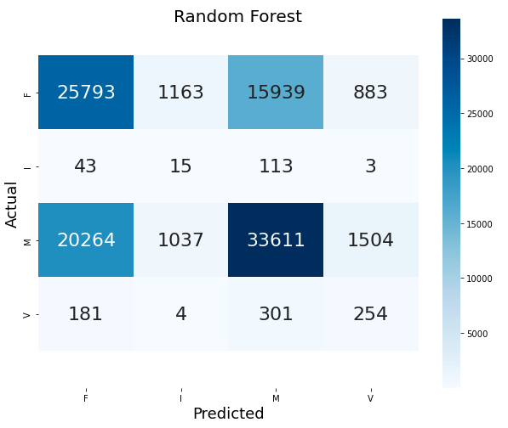
Confusion Matrix
43778
174
56416
740
Total:
101,108
46281 2644 2219 49964

Slide 33
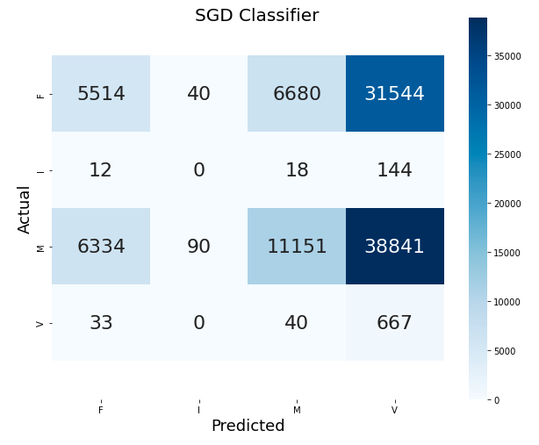
Confusion Matrix (Cont..)

Slide 34
Conclusion
K-modes is a better clustering method than hierarchical clustering for large datasets containing categorical data.
Race and Age alone does not classify arrests.
For supervised learning, we used perpetrator demographics and location to predict type of crimes
This was a multi-label classification problem with imbalance dataset
Logistic regression and SGD classifiers were the low performing while Random Forest gave the best accuracy.
Notes:
The data doesn’t give enough information. It only has categorical data and missing a lot of factors to predict the level of crime. We have no idea that if the arrested individual was proven guilty or not. Sometimes they are arrested for no reason. They can be victim of racism and stereotype by the police officer. We ca

Slide 35
Future Work
Compare K-Modes using Cao Method to the results obtained from using Huang Method
Researching/developing more efficient and less costly models for categorical datasets + building better data pipelines
Expanding dataset to have more features (demographics, indictments after arrests, rearrests, if they were arrested before too)
Corrections for bias
Notes:
The Cao method take into consideration the distribution of the attribute values on the whole dataframe, so it selects the initial centroids based on object density and distance between objects to formulate the dissimilarity score. Huang’s method sets the first k objects as the initial clusters centers and selects the most frequent attributes as the equal to the k initial cluster centers.
More encompassing picture of the problem, better variables?

Slide 36
THANK YOU!
Notes:
tenzin

